Slide 1
Applied Physics(C. Sc.) BS CS Semester-I Course Code: L-12(Transmission of heat via conduction, convection and radiation) IUB & All Affiliated Colleges. Reality Awards Boost Up (YT-Channel)
Rushmat Ali
Assistant Professor OF Physics
Govt. Kh. F. Graduate College R. Y. Khan

Slide 2
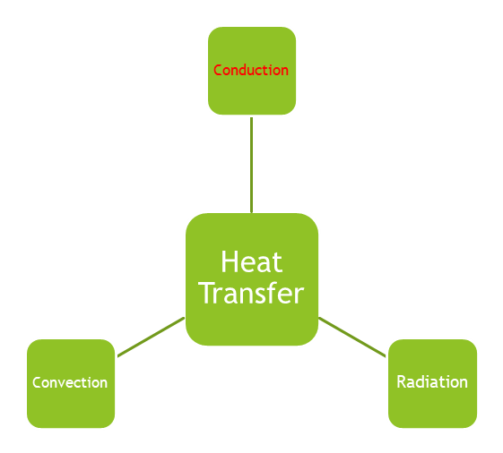
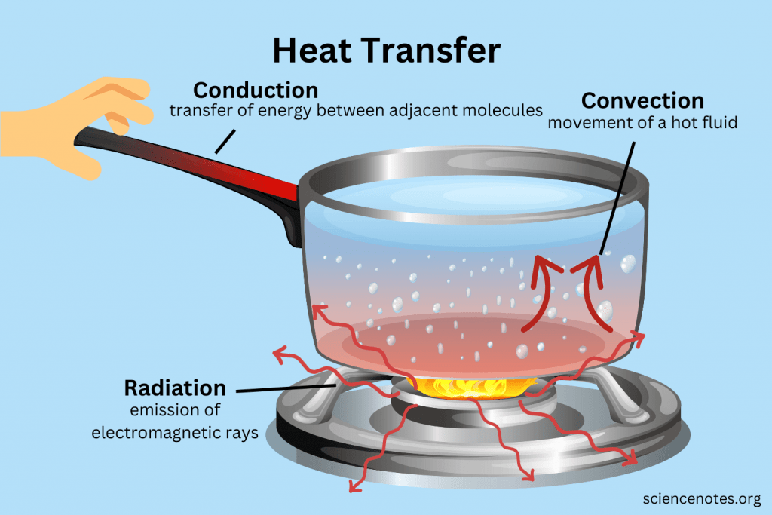
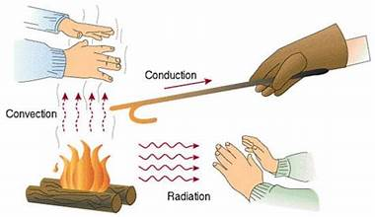
What is a heat transfer process?
Heat transfer is defined as the process in which the molecules are moved from the region of higher temperature to lower temperature.
There are three types of heat transfer.
Conduction, convection, and radiation are the types of heat transfer.
Heat transfer is the movement of heat due to a temperature difference between a system and its surroundings.
The energy transfer is always from higher temperature to lower temperature, due to the second law of thermodynamics.
The units of heat transfer are the joule (J), calorie (cal), and kilocalorie (kcal).
The unit for the rate of heat transfer is the kilowatt (KW).
Conduction requires contact.
Convection requires fluid flow.
Radiation does not require any medium.

Slide 3
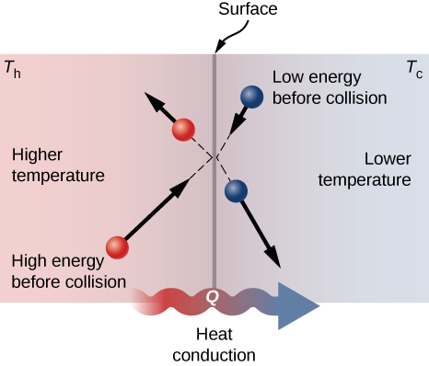
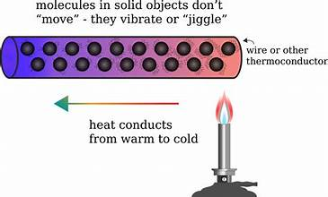
1. Conduction:
Conduction is heat transfer directly between neighboring atoms or molecules. Usually, it is heat transfer through a solid. Conduction requires that molecules touch each other, making it a slower process than convection or radiation.
Microscopic Approach: Matter consists of Atoms and molecules which interact with a lot of energy have more kinetic energy and engage in more collisions with other matter. They are “hot.” When hot matter interacts with cold matter, some energy gets transferred during the collision. This drives conduction. Forms of matter that readily conduct heat are called thermal conductors, which do not conduct heat are insulators
Examples of Conduction: Conduction is a common process in everyday life. For example:
Holding an ice cube immediately makes your hands feel cold. Meanwhile, the heat transferred from our skin to the ice melts it into liquid water.
Walking barefoot on a hot road or sunny beach burns our feet because the solid material transmits heat into foot.
Iron clothes transfers heat from the iron to the fabric.
The handle of a coffee cup filled with hot coffee becomes warm or even hot via conduction through the mug material.

Slide 4
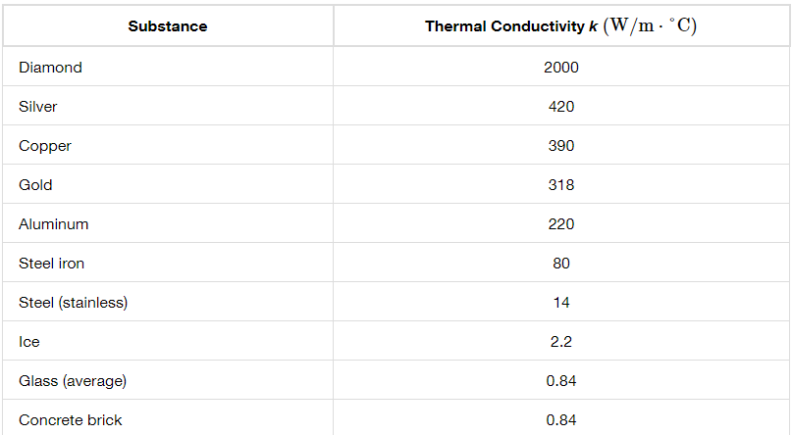
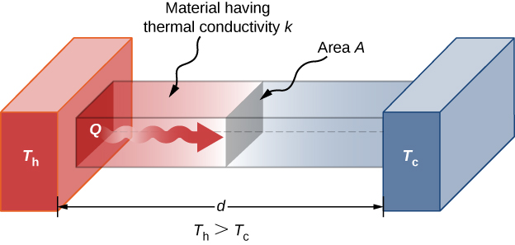
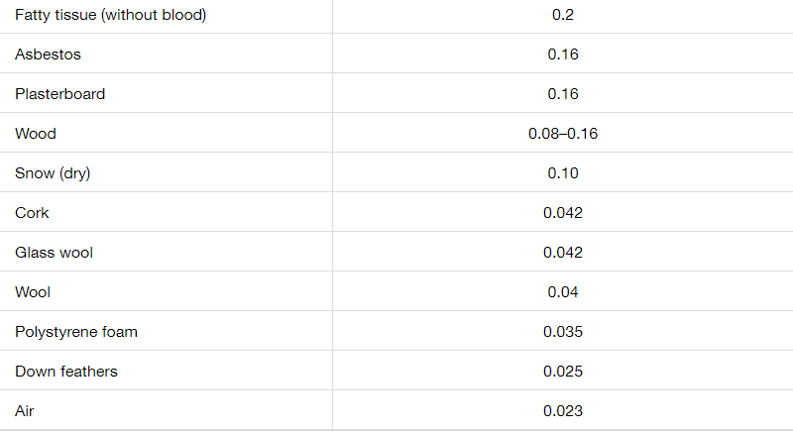

Relation for heat Conduction
Consider a metallic system consisting of two boxes like separated by a small distance d and small thin sheet of barrier of area A. Let the left end is at high temperature Th and the right end is at low temperature Tl such that Th >Tl.
Due to temperature difference, $∆T=Th −Tl, heat ∆Q$Flows from high to low temperature.
It is experimentally, found that: $∆Q ∞$ A; $∆Q ∞ ∆T; ∆Q∞\frac{1}{d}$
=> $∆Q=k A \frac{∆T}{d}$
Here k= is proportionality constant= Thermal conductivity = k= $\frac{∆Q d}{A ∆T} \left(J m^{−1}K^{−1}\right).$
The value of k depends upon nature of substance, area of sheet, Temperature difference and separation between two surfaces.
For infinitesimal small separation, d => dx (Horizontal ) time $∆t⇒0$,
Differentiating the above equation w.r.t. time, Power can be obtained.
P= $\min_{∆t⇒0}{\frac{∆Q}{∆t}=\frac{dQ}{dt}} ⇒ P=k A \frac{dT}{dx}$

Slide 5
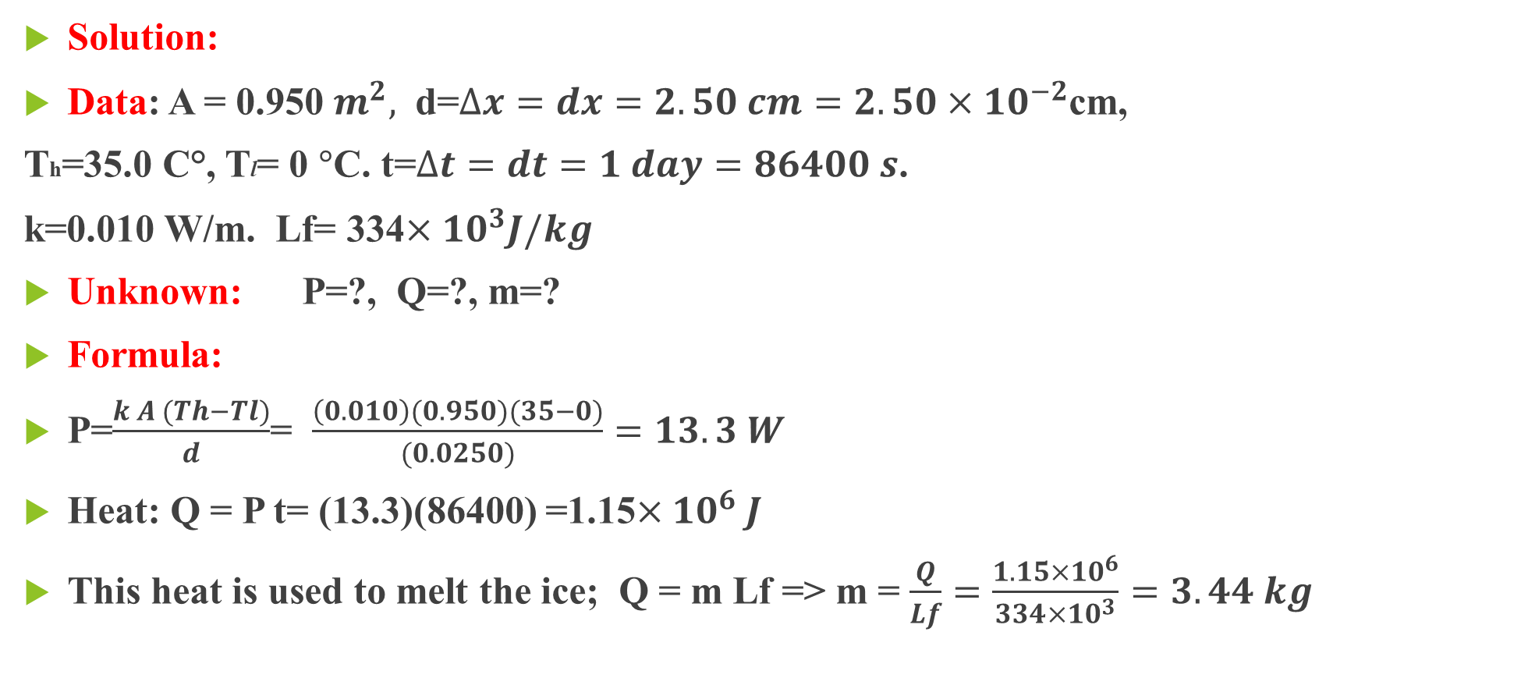
Problem: Calculating Heat Transfer through Conduction A polystyrene foam icebox has a total area of 0.950m2 and walls with an average thickness of 2.50 cm. The box contains ice, water, and canned beverages at 0°C. The inside of the box is kept cold by melting ice. How much ice melts in one day if the icebox is kept in the trunk of a car at 35.0ºC?
Solution:
Data: A = 0.950 $m^{2},$ d=$∆x=dx=2.50 cm=2.50×{10}^{−2}$cm,
Th=35.0 C°, Tl= 0 $°$C. t=$∆t=dt=1 day=86400 s$.
k=0.010 W/m. Lf= 334$×{10}^{3}J/kg$
Unknown: P=?, Q=?, m=?
Formula:
P=$\frac{k A (Th−Tl)}{d}$= $\frac{\left(0.010\right)(0.950)(35−0)}{(0.0250)}=13.3 W$
Heat: Q = P t= (13.3)(86400) =1.15$×{10}^{6} J$
This heat is used to melt the ice; Q = m Lf => m = $\frac{Q}{Lf}=\frac{1.15×{10}^{6}}{334×{10}^{3}}=3.44 kg$

Slide 6
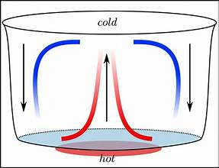
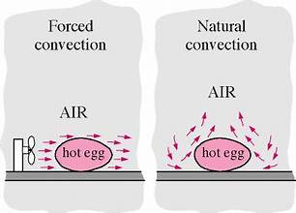
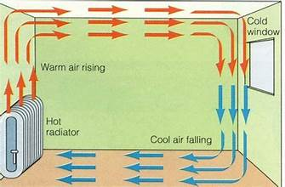
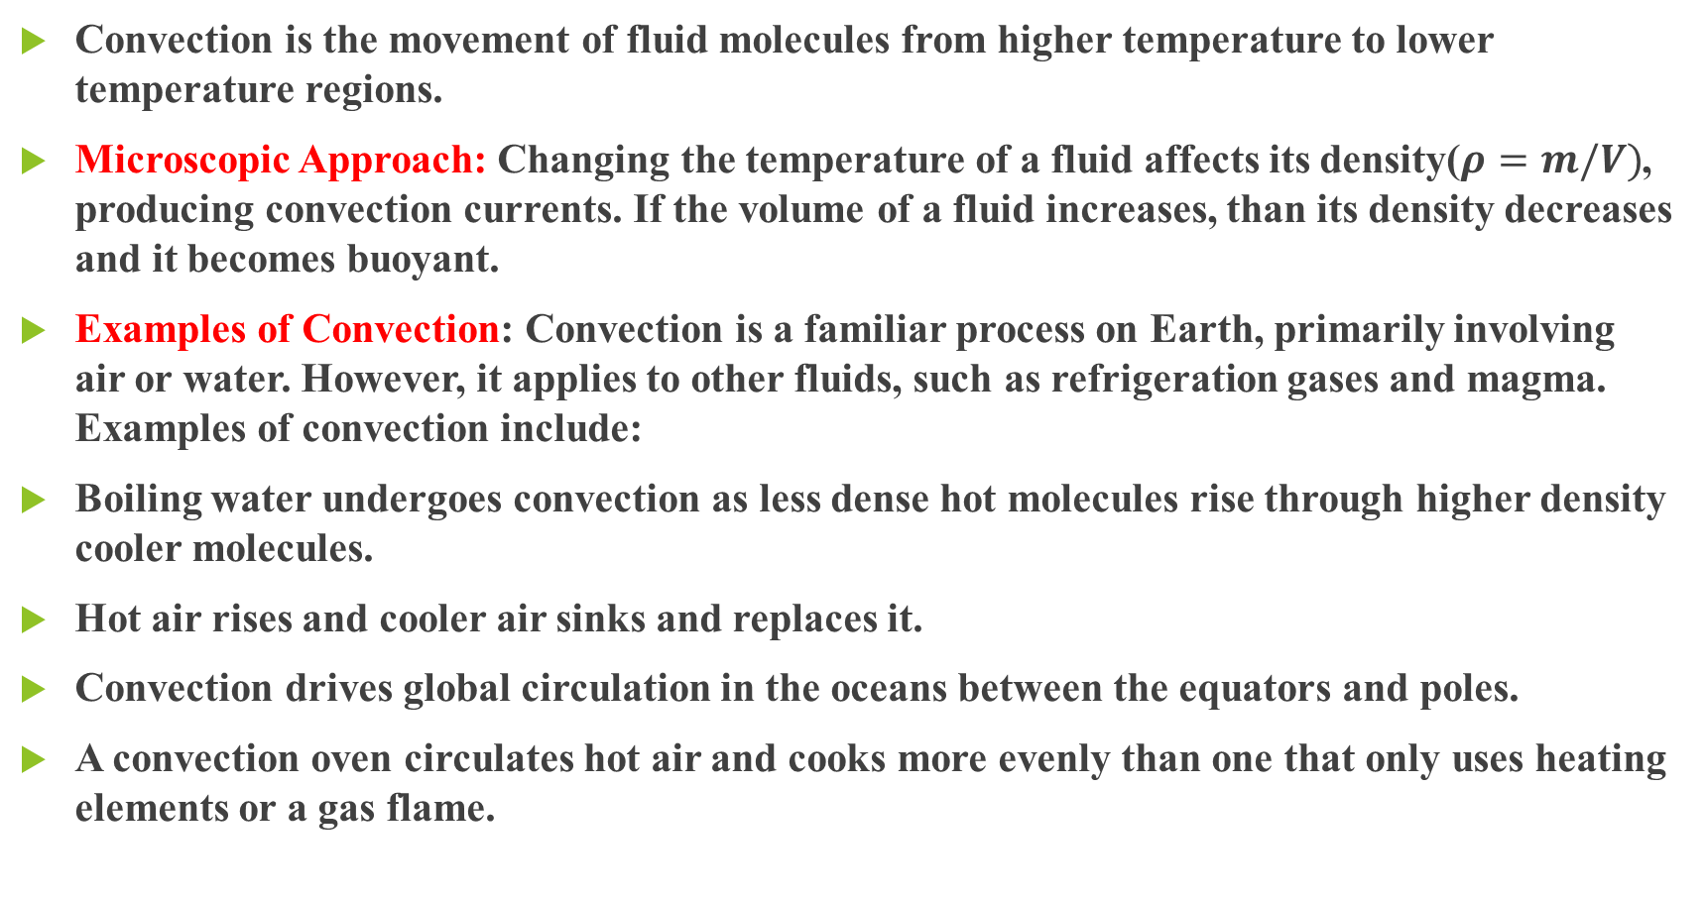
Convection
Convection is the movement of fluid molecules from higher temperature to lower temperature regions.
Microscopic Approach: Changing the temperature of a fluid affects its density($ρ=m/V)$, producing convection currents. If the volume of a fluid increases, than its density decreases and it becomes buoyant.
Examples of Convection: Convection is a familiar process on Earth, primarily involving air or water. However, it applies to other fluids, such as refrigeration gases and magma. Examples of convection include:
Boiling water undergoes convection as less dense hot molecules rise through higher density cooler molecules.
Hot air rises and cooler air sinks and replaces it.
Convection drives global circulation in the oceans between the equators and poles.
A convection oven circulates hot air and cooks more evenly than one that only uses heating elements or a gas flame.

Slide 7
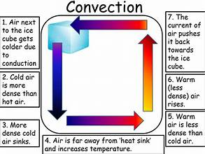
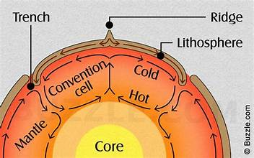

Convection Equation
Consider a fluid is contained in a vessel with top open with temperature Ts and bottom is placed on burning stove with temperature Tb. Let the Area of vessel is A.
It is experimentally found that, Heat transferred depends upon, area A, temperature difference $∆T=Tb −Ts$
i.e. $∆Q∞ A, ∆Q ∞ ∆T,$
=> $∆Q=Hc A ∆T$
=> Rate of Convection= P =$\frac{∆Q}{∆t}=Hc A \frac{∆T}{∆t}$
The equation for the rate of convection relates area and the difference between the fluid temperature and surface temperature:
Here, Hc = proportionality constant= $\frac{∆Q }{A ∆T}(J m^{−2}K^{−1})$
It depends upon: Area of vessel, Heat transferred, Temperature change.

Slide 8
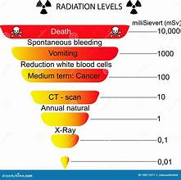
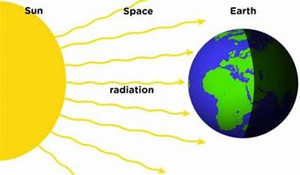
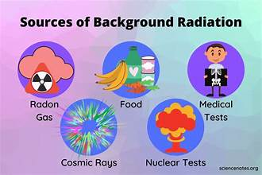
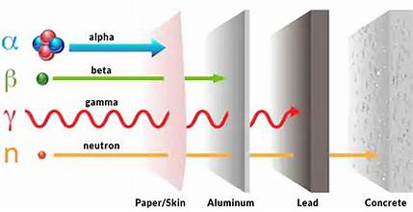

Radiation
Radiation is the release of electromagnetic energy. Another name for thermal radiation is radiant heat.
Unlike conduction or convection, radiation requires no medium for heat transfer.
Radiation occurs both within a medium (solid, liquid, gas) or through a vacuum.
Examples of Radiation:
There are many examples of radiation:
A microwave oven emits microwave radiation, which increases the thermal energy in food
The Sun emits light (including ultraviolet radiation) and heat
Uranium-238 emits alpha radiation as it decays into thorium-234
Radiation Equation: The Stephan-Boltzmann law describes relationship between the power and temperature of thermal radiation: $∆Q=e σ A ({∆T)}^{4}$
Here, e:Emissivity, $σ:Stefen^{′}s Constant=$5.67 × ${10}^{−8}$ W ⋅ $m^{−2}$.

Slide 9
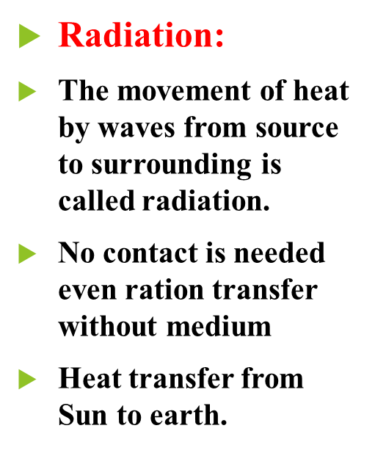
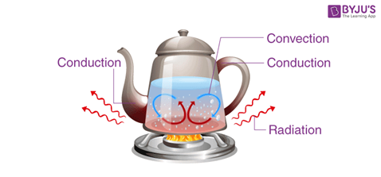
A comparison among conduction, convection & Radiation
Conduction:
The transfer of heat by direct contact between two materials due to temperature difference is called conduction.
Physical contact is needed.
Heat transfer from source to fluid through metal.
Convection:
The movement of heat by molecules of medium from source to surrounding is called convection.
No contact is needed, moving molecules produce heat current I a medium
Heat transfer from Sun to earth.

Slide 10
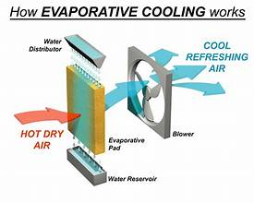
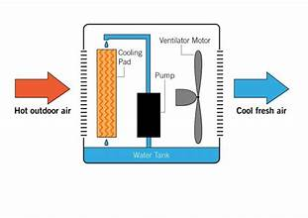
More Heat Transfer …….
While conduction, convection, and radiation are the three modes of heat transfer, other processes absorb and release heat.
For example, atoms release energy when chemical bonds break and absorb energy in order to form bonds.
Releasing energy is an exergonic process, while absorbing energy is an endergonic process.
Sometimes the energy is light or sound, but most of the time it’s heat, making these processes exothermic and endothermic.
Phase transitions between the states of matter also involve the absorption or release of energy.
A great example of this is evaporative cooling, where the phase transition from a liquid into a vapor absorbs thermal energy from the environment.

Slide 11
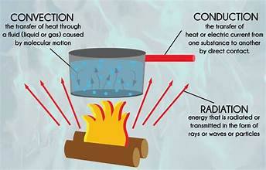
What is the difference between conduction and thermal radiation?
Conduction involves molecules transferring kinetic energy to one another through collisions.
Convection occurs when hot air rises, allowing cooler air to come in and be heated.
Thermal radiation happens when accelerated charged particles release electromagnetic radiation, which can be felt as heat.
The End

